Slide 1

Facebook Live Sellers: Engagement Analytics
An in-depth analysis of retail behavior and interaction patterns within the Thai fashion and cosmetics market.
DATA SCIENCE PROJECT | THAILAND 2024

Slide 2
The Data Landscape
Analyzing 7,050 records to uncover what drives customer engagement.

Slide 3
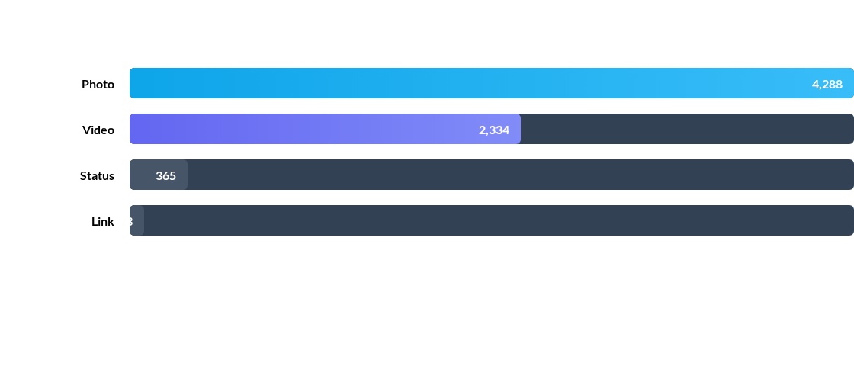
POST VOLUME BY TYPE
Photos represent the majority of content volume (61%), yet the engagement narrative tells a different story regarding value.

Slide 4
ENGAGEMENT BENCHMARKS
Medium | Avg Reactions | Avg Comments | Avg Shares
Video | 283.4 | 642.5 | 115.7
Status | 438.8 | 36.2 | 2.6
Photo | 181.3 | 16.0 | 2.6
Note: Videos generate 40x more comments on average than standard photo posts.

Slide 5
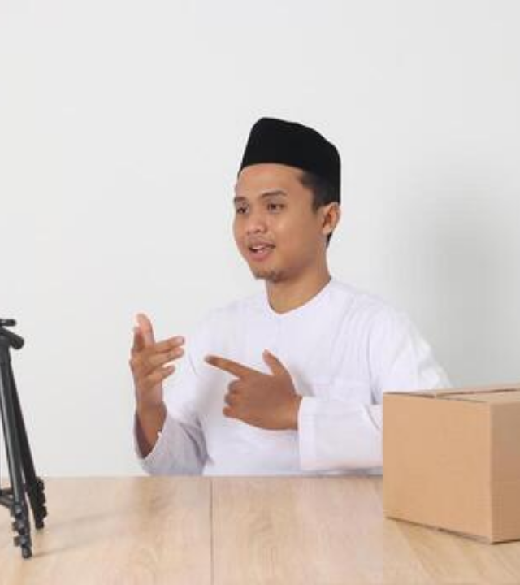
THE VIDEO MULTIPLIER
Interactivity at Scale
Live video sessions are the engine of conversational commerce in Thailand. They don't just reach people; they create dialogue.
The high comment-to-share ratio in video content suggests that these formats are the primary driver for direct sales inquiries.

Slide 6
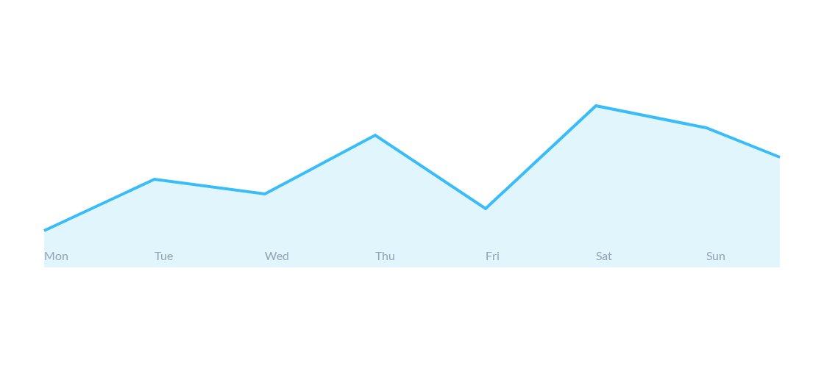
DAILY REACTION CYCLES
Average reactions peak significantly on Saturdays, suggesting a high weekend readiness for social shopping.

Slide 7
ENGAGEMENT CONNECTIVITY
0.64
Comments & Shares
Our analysis shows a strong positive correlation between the number of comments and shares.
This suggests that content which triggers deep conversation is also the most likely to be amplified through user networks, creating an organic viral loop.
Correlation Coefficient

Slide 8
Segmentation Strategy
Using K-Means Clustering to group post behaviors.

Slide 9
OPTIMAL CLUSTER COUNT
4
The Elbow Method
By analyzing the within-cluster sum of squares (Inertia), the Elbow Method identified 4 as the optimal number of clusters.
Distinct Profiles
This provides the best balance between model simplicity and accurate representation of diverse engagement behaviors.

Slide 10








BEHAVIORAL PROFILES
Standard
Conversational
Popular
Elite
89% of posts. Low but stable engagement across all metrics.
High comment volume (Avg 2,950+). These are the active buyers.
High reaction counts but low depth of share. Viral "scrollers."
The top 1%. Outliers with massive "Wow" and share metrics.

Slide 11
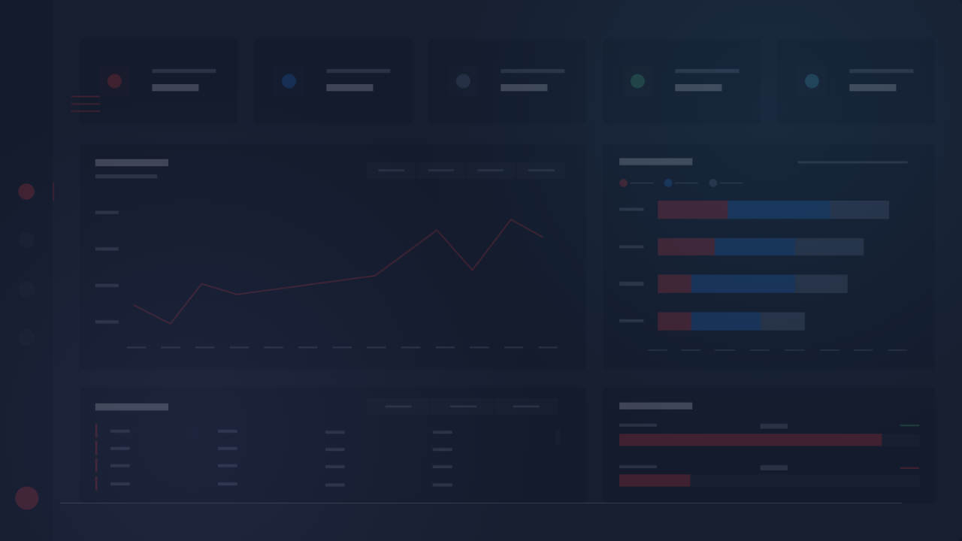
Strategic Insights
Focus on Interactivity
Optimize Post Timing
Video content is king for conversion. Prioritizing live formats increases comment volume, which we know correlates strongly with shares.
Leverage the Saturday surge for high-stakes product launches. Mid-week posts should focus on status updates to maintain reaction volume.

Slide 12

Thank You
For your time and attention.

Slide 13


IMAGE SOURCES
https://static.vecteezy.com/system/resources/thumbnails/042/533/615/small/portrait-of-excited-asian-muslim-man-in-koko-shirt-with-skullcap-promoting-his-product-on-live-streaming-session-online-shopping-with-smartphone-concept-isolated-image-on-white-background-photo.JPG
Source: www.vecteezy.com
https://cdn.prod.website-files.com/5efb0b7816032fd33ce6059c/62d5ba2d8421b161d7433fcc_Group%201914.png
Source: www.numerro.io

